Slide 1

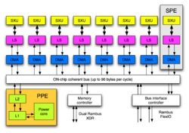


Accelerator-based Implementation of the Harris Algorithm
Claude TADONKI
Mines ParisTech – CRI (Centre de Recherche en Informatique)
Fontainebleau (France)
claude.tadonki@mines-paristech.fr
Joint work with
Lionel Lacassagne, Elwardani Dadi, Mostafa El Daoudi
International Conference on Image and Signal Processing 2012 (ICISP 2012)
June 28-30, Agadir, Morocco

Slide 2
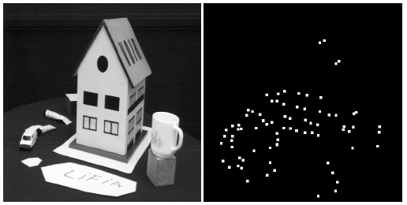
Accelerator-based Implementation of the Harris Algorithm
C. Tadonki - Mines ParisTech
The Harris-Stephen algorithm
its a corner (point of interest) detection algorithm
it is an improved variant of the original algorithm by Moravec
it is used in computer vision for feature extraction like
  motion detection
  image matching
  tracking
  3D reconstruction
  object recognition
International Conference on Image and Signal Processing 2012 (ICISP’12)
June 28-30, Agadir, Morocco

Slide 3

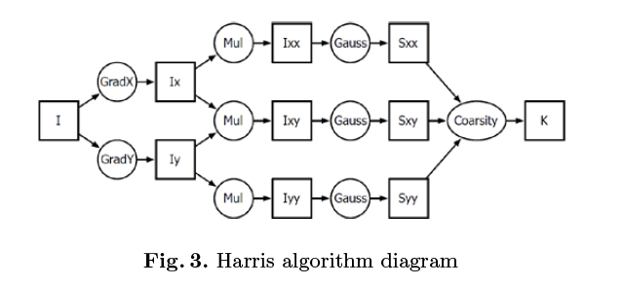
Accelerator-based Implementation of the Harris Algorithm
C. Tadonki - Mines ParisTech
Technically, the Harris algorithm is based on a pixelwise autocorrelation S given by
where (x, y) is the location of the pixel and I(x, y) its intensity (grayscale mode).
At a given point (x, y) of the image, the value of S(x, y) is compared to a suitable threshold, and the decision follows on the nature of the pixel at (x, y).
Roughly speaking, the process is achieved by applying four discrete operators, namely
Sobel (S), Multiplication (M), Gauss (G), and Coarsity (C).
The figure below displays an overview of the global workflow.
International Conference on Image and Signal Processing 2012 (ICISP’12)
June 28-30, Agadir, Morocco

Slide 4
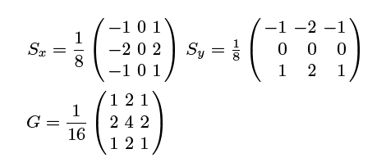
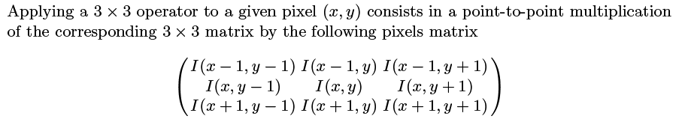
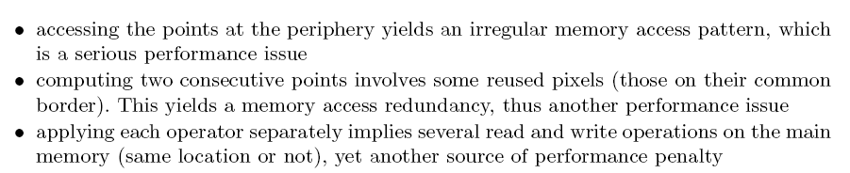
Accelerator-based Implementation of the Harris Algorithm
C. Tadonki - Mines ParisTech
Sobel and Gauss, which aproximate the first and the second derivatives respectively, are
9->1 or 3x3 operators represented by the following 3x3 matrices
Computational issued
International Conference on Image and Signal Processing 2012 (ICISP’12)
June 28-30, Agadir, Morocco

Slide 5
Accelerator-based Implementation of the Harris Algorithm
C. Tadonki - Mines ParisTech
In order to reduce the repetitive read/write of the entire image, one could fuse or chain
consecutive operators whenever possible. But, this implies redundant computations.
In order to improve data locality, as this is an important point here (due to the stencil form of the computation), we consider the common technique of tiling.
In practice, when it comes to special devices, where there there is a strong constraint on memory alignment, it is more simple to consider row tiles (i.e. a tile is a group of consecutive rows). This simplifies memory accesses implementation, but the performance is not optimal since the shape of the optimal tile is a square.
In this work, we provide a generic routine to perform memory transfers of rectangle shapes on the IBM CELL machine and illustrate its efficiency on a tile implementation of the Harris algorithm.
International Conference on Image and Signal Processing 2012 (ICISP’12)
June 28-30, Agadir, Morocco

Slide 6
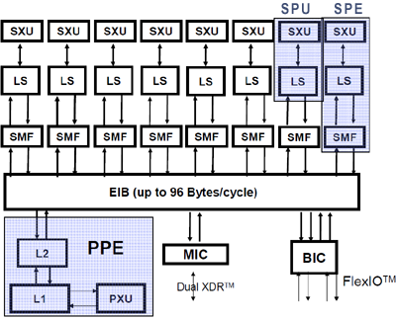
Accelerator-based Implementation of the Harris Algorithm
C. Tadonki - Mines ParisTech
The IBM CELL machine
a multi-core chip composed of 9 processing elements:
  1 master unit (POWER PC), called Power Processing Element (PPE)
  8 Synergistic Processing Elements (SPE), with SIMD capability & a local memory (256K)
data transfers between the main memory and the SPE memory are done trough DMAs
DMA (direct memory access) has some important constraints on both the address and
the volume of the data to be transferred, and it can be done in parallel with computations
International Conference on Image and Signal Processing 2012 (ICISP’12)
June 28-30, Agadir, Morocco

Slide 7
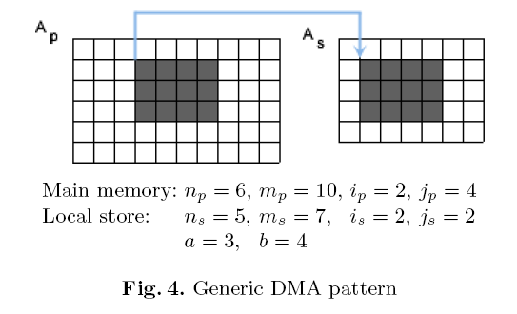
Accelerator-based Implementation of the Harris Algorithm
C. Tadonki - Mines ParisTech
DMA issues related to tiling
Performing the transfer expressed in figure 4 raises number of problems:
• the region to be transferred is not contiguous on memory, thus list DMAs are considered
• the address of one given row is not aligned, thus the global list DMA is not possible
• the (address, volume) pair of a row does not match the basic DMA rules (the above two
ones), thus the entire list DMA cannot be carried out
• misalignment could come from both sides (main memory and/or local store)
• the target region on the local store might be out of the container limits
We have designed and implemented a routine which performs this task very efficiently
International Conference on Image and Signal Processing 2012 (ICISP’12)
June 28-30, Agadir, Morocco

Slide 8
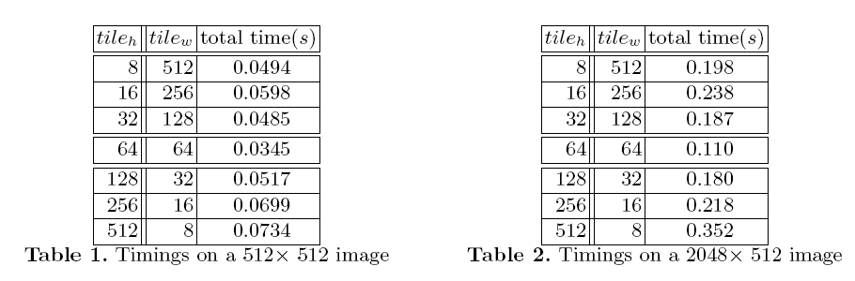
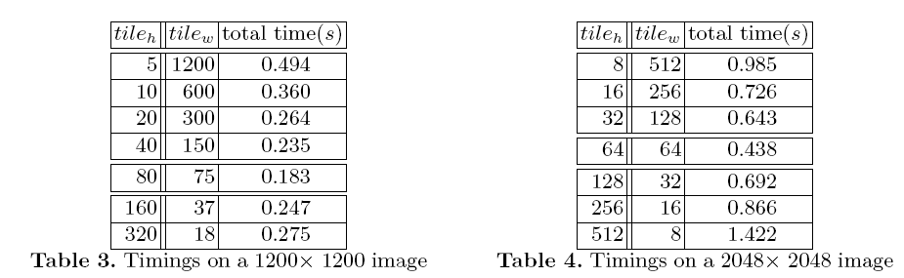
Accelerator-based Implementation of the Harris Algorithm
C. Tadonki - Mines ParisTech
Performance results on the Harris algorithm
We can observe 50% improvment between square tiles and full row tiles.
International Conference on Image and Signal Processing 2012 (ICISP’12)
June 28-30, Agadir, Morocco

Slide 9
Accelerator-based Implementation of the Harris Algorithm
C. Tadonki - Mines ParisTech
Conclusion and perspectives
This work shows that, when using accelerators, it is important to have an efficient
Implementation of the transfers between the main memory and the local memory of the
accelerators.
Due to the current status of the CELL, we need to explore our ideas on GPUs.
International Conference on Image and Signal Processing 2012 (ICISP’12)
June 28-30, Agadir, Morocco

Slide 10
Accelerator-based Implementation of the Harris Algorithm
C. Tadonki - Mines ParisTech
THANKS FOR YOUR ATTENTION
International Conference on Image and Signal Processing 2012 (ICISP’12)
June 28-30, Agadir, Morocco

