Slide 1
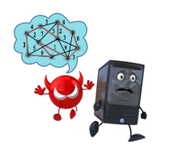




Mines-ParisTech
Université Paris-Sud / 16 mai 2013

Slide 2
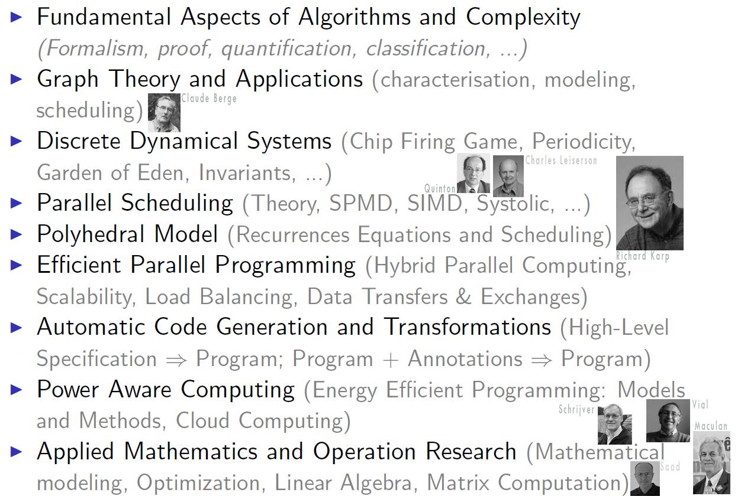

My Research Topics so far
“A vouloir toujours aller au fond des choses, on court le risque d’y rester."
Claude Tadonki
Mines ParisTech
High Performance Computing as Combination of Machines and Methods and Programming
HDR defense - University Paris-Sud/Orsay - PCRI - May 16th 2013

Slide 3
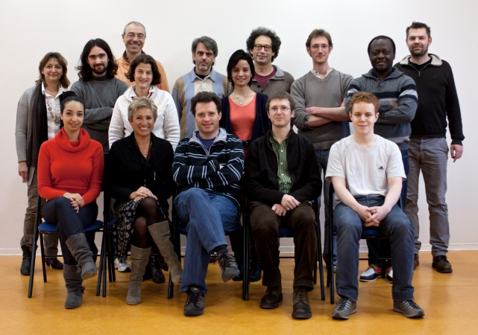


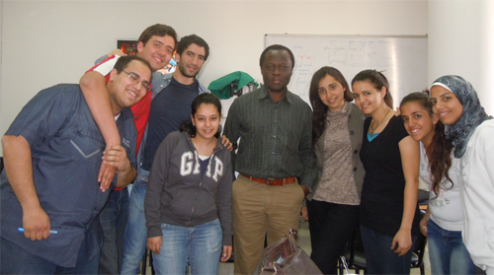
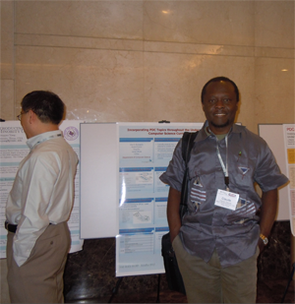
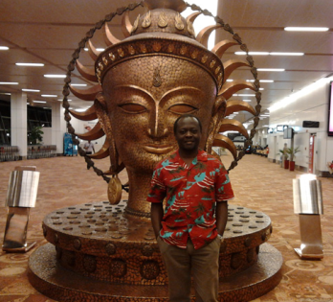
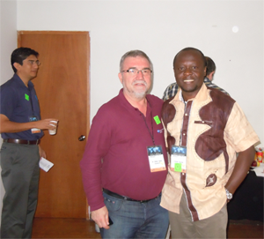
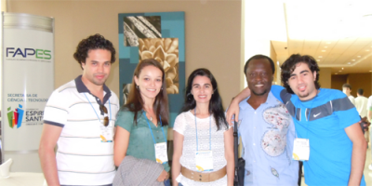
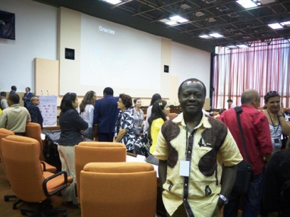
Places where I have been (study/work/conference/cooperation/teaching)
University of Yaoundé (Cameroon) → University of Rennes/IRISA → University of Geneva (HEC/CUI)
→ European Laboratory of Molecular Biology → University Paris-Sud → Ecole des Mines de Paris
92: CARI
97:CEPAMOQ
«science without border »
is the hallmark of my route.
France
Italy
Spain
Argentina
Austria
Switzerland
Germany
Hungary
Madagascar
Brazil
Romania
Portugal
Finland
Senegal
UK
Danmark
Greece
USA
Morroco
Ireland
Canada
Mexico
Cuba
Egypt
India
Madagascar
China
Japan
Cameroon
Claude Tadonki
Mines ParisTech
High Performance Computing as Combination of Machines and Methods and Programming
HDR defense - University Paris-Sud/Orsay - PCRI - May 16th 2013

Slide 4

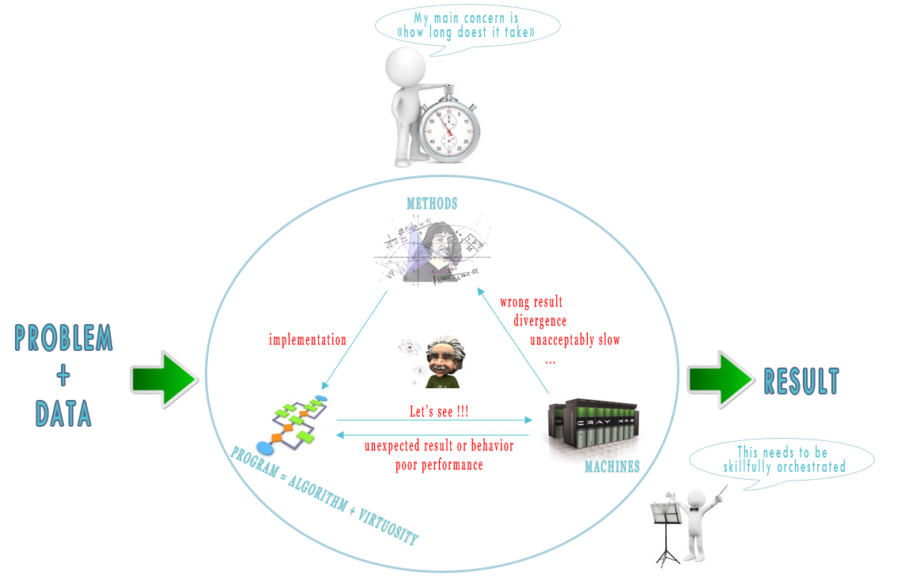




The HPC Symphony
Mystery {
Significant advances have been achieved in each of the aforementioned aspects.
A skillfull combination of all HPC components is really the key to absolute efficiency.
This expected pluridiscipline interaction should be better done at the earliest.
This is the main point of my defense and the motivation behind my future plans.
Claude Tadonki
Mines ParisTech
High Performance Computing as Combination of Machines and Methods and Programming
HDR defense - University Paris-Sud/Orsay - PCRI - May 16th 2013

Slide 5
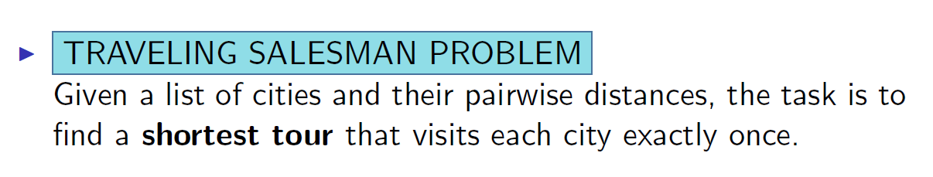
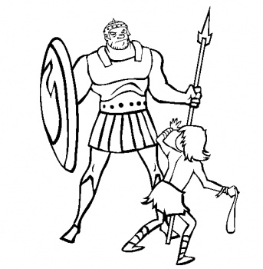
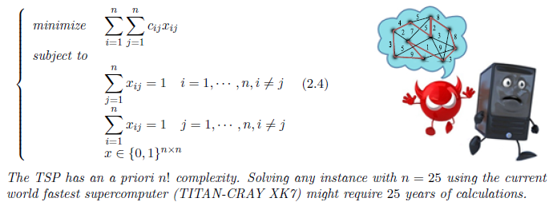
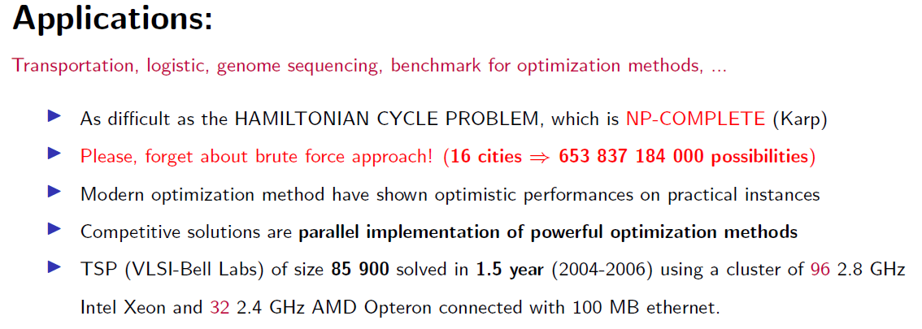
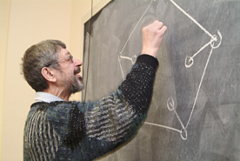
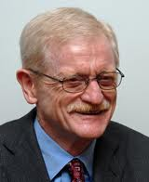
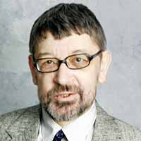
Computer vs Difficult Problem ≡ David & Goliath
NP-complete Problem
+ Subtour breaking constraints
TITAN in 1min ≈ 6 billion people calculating
24h/24h during 300 years
Method
“Tu quieres celeste que te cueste."
(Super)Computer
TSP heros: Applegate, Bixby, Chvatal, and Cook
Approximation algorithm is also an interesting pragmatic way to go
Claude Tadonki
Mines ParisTech
High Performance Computing as Combination of Machines and Methods and Programming
HDR defense - University Paris-Sud/Orsay - PCRI - May 16th 2013

Slide 6

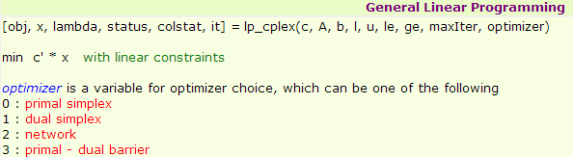
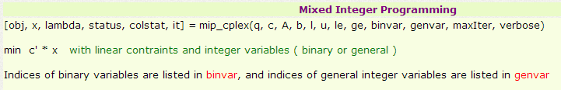
Influence of Programming on Methods
Quicksort is a worst-case n² algorithm, but is still preferred to the nlogn heapsort.
LP can be solved in a polynomial time, but the (expontial) SIMPLEX is still preferred.
The simplex has led to the leading solver CPLEX
We have implemented a nice interface between CPLEX and MATLAB in
cooperation with David Musicant (Carleton College) and Travis Johnson.
Our interface (started in 2004) has been used and cited in several mathematical programming papers, including ours (P-median, Portfolio, Energy minimization ).
Can be dowloaded at
http://www.omegacomputer.com/staff/tadonki/using_cplex_with_matlab.htm
Claude Tadonki
Mines ParisTech
High Performance Computing as Combination of Machines and Methods and Programming
HDR defense - University Paris-Sud/Orsay - PCRI - May 16th 2013

Slide 7
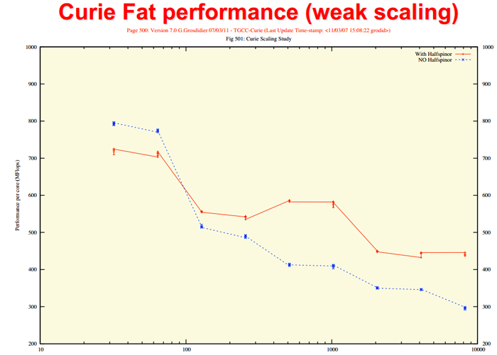

A Large-Scale Particles Physics Problem
High-precision Lattice Quantum ChromoDynamics simulations.
The ANR project PetaQCD was targeting 256×128³ lattices.
One evaluation of the Dirac operator on a 256×128³ lattice involves
256 × 128³ × 1500 ≈ 10¹² (stencil) floating-point operations
With 10,000 cores, we can roughly
perform 500 × 10³ × 10⁶ = 5x10⁹ fps
Our 256×128³ lattice would then
require 200 seconds ≈ 3 minutes
for each evaluation of the Dirac
operator.
10 days !!!
Now, image that we have
to do it 5000 times to solve
One Dirac linear system !!!
G.Grosdidier, « Scaling stories », PetaQCD Final Review Meeting, Orsay, Sept. 27th – 28th 2012
500 Mflops/core
Claude Tadonki
Mines ParisTech
High Performance Computing as Combination of Machines and Methods and Programming
HDR defense - University Paris-Sud/Orsay - PCRI - May 16th 2013

Slide 8
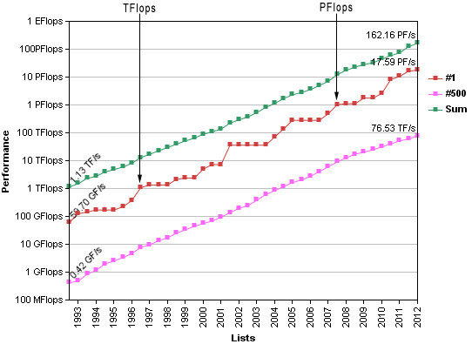




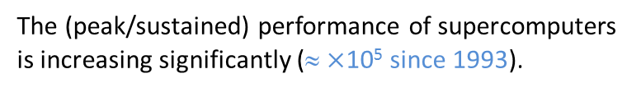
Important Facts about Supercomputers
The (peak/sustained) performance of supercomputers is increasing significantly (≈ $×$10⁵ since 1993).
The following characteristics are becoming a standard
Several cores (2012 list: 84% ≥ 6 cores and 46% ≥ 8 cores)
Vector units (with larger vector registers)
Accelerated (mainly GPU: 62 systems of the 2012 including the #1)
The gap between peak and sustained performances
on real-life applications is clearly questionable.
Performance evolution (Top500.org)
HPC investigations should focus on this.
When it comes to accelerators, data transfer is
critical.
Compromise and overlap (scheduling)
Taking advantage of all aspects of a computing
nodes requires a complex hybrid/heterogeneous
programming .
TITAN CRAY-XK7 the (2012) world fastest supercomputer
  299 008 CPU cores (16-cores AMD Opteron 6274)
  18 688 NVIDIA Tesla K20 GPUs
  Peak: 27.11 PFlop/s.
  Sustained: 17.59 PFlop/s (Linpack)
Code generation and transformation
Energy is major concern.
Power aware programming and scheduling.
Claude Tadonki
Mines ParisTech
High Performance Computing as Combination of Machines and Methods and Programming
HDR defense - University Paris-Sud/Orsay - PCRI - May 16th 2013

Slide 9
Some of my achievements
Let’s have a look on some of my achievements
"Only those who attempt the absurd...will
achieve the impossible." M. C. Escher
Claude Tadonki
Mines ParisTech
High Performance Computing as Combination of Machines and Methods and Programming
HDR defense - University Paris-Sud/Orsay - PCRI - May 16th 2013

Slide 10
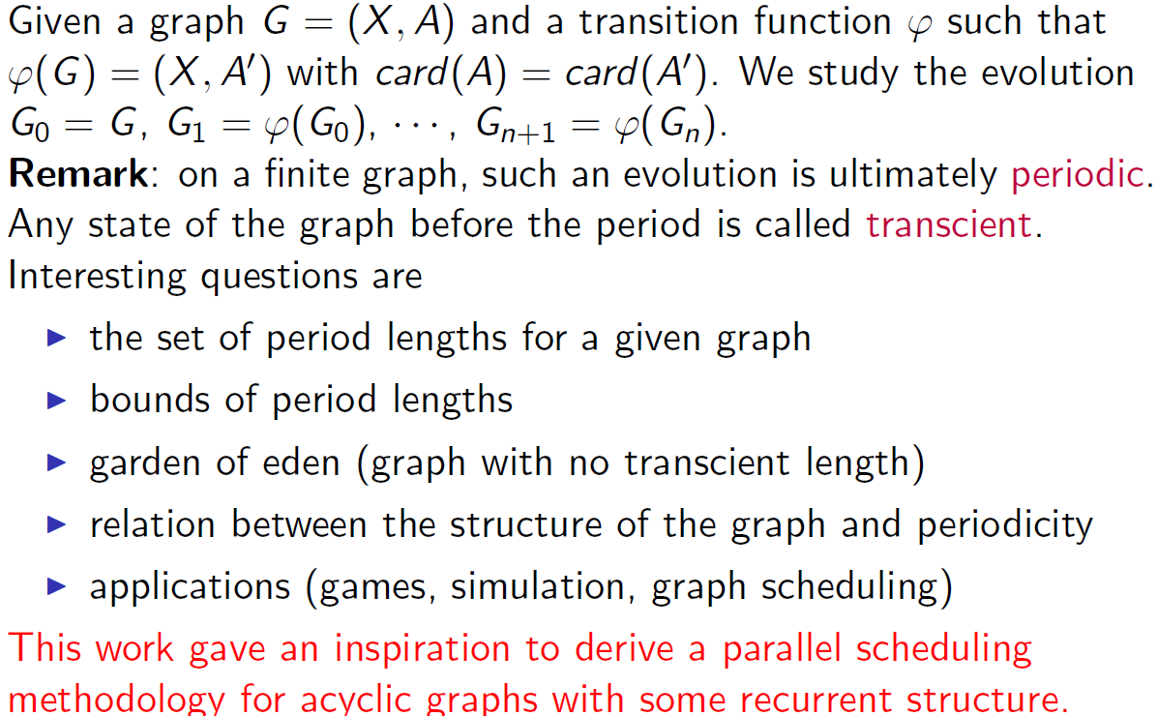
Discrete Dynamical Systems
René Ndoundam, Claude Tadonki, Maurice Tchuente: Parallel Chip Firing Game Associated with n- cube Edges Orientations. International Conference on Computational Science (2004). , CoRR abs/1007.0381 (2010)
Claude Tadonki
Mines ParisTech
High Performance Computing as Combination of Machines and Methods and Programming
HDR defense - University Paris-Sud/Orsay - PCRI - May 16th 2013

Slide 11
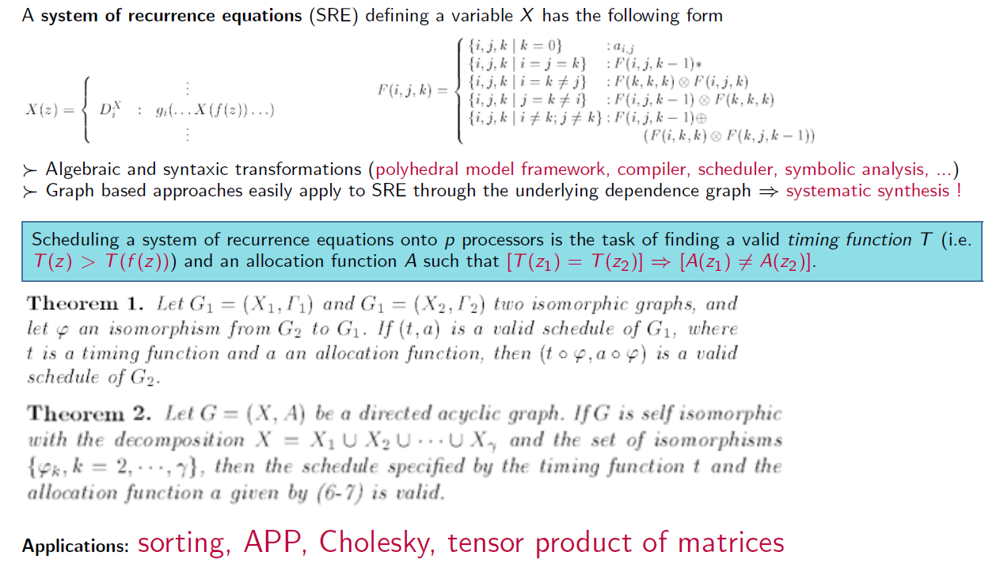
Parallel Scheduling
Our scheduling method (already published) opens the following perspectives
Implementation as a scheduling module into a polyhedral model based framework.
Study of an appropriate graph clustering (hybrid parallelism or modularity)
Inclusion of hardware parameters
Claude Tadonki
Mines ParisTech
High Performance Computing as Combination of Machines and Methods and Programming
HDR defense - University Paris-Sud/Orsay - PCRI - May 16th 2013

Slide 12
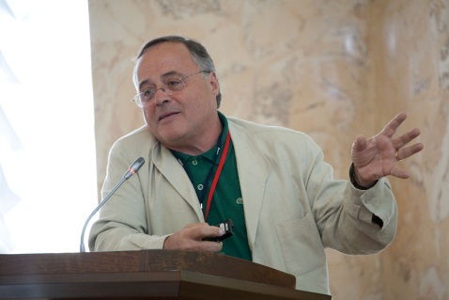
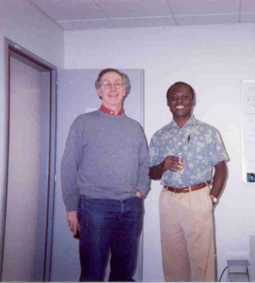
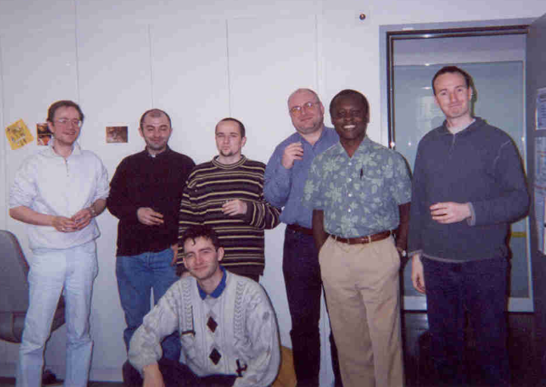
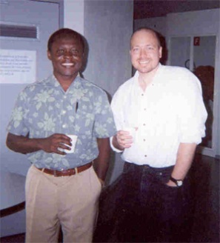
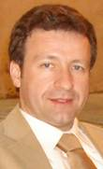
LOGILAB (University of Geneva)
Inside the LOGILAB, Operation Research Laboratory
founded by Pr Jean-Philippe Vial and Pr Alain Haurie
at the University of Geneva (Switzerland)
Dealing with modern, efficient, and somehow pragmatic approaches
for modeling and solving difficult real-world problems
Think about gaussian pivoting vs iterative methods
Claude Tadonki
Mines ParisTech
High Performance Computing as Combination of Machines and Methods and Programming
HDR defense - University Paris-Sud/Orsay - PCRI - May 16th 2013

Slide 13
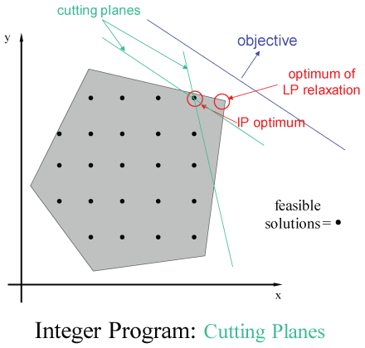
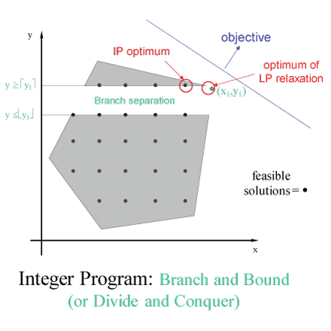
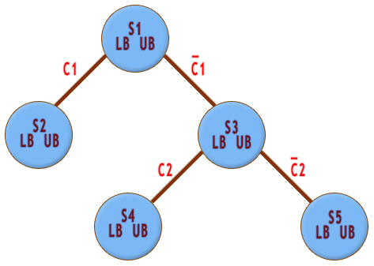
Optimization
Practical instances of discrete (pure or mixed) optimization problems
are better solved though a skillfull combination of continuous optimization
techniques and branch&bound-like mechanisms.
For a pure discrete problem, a relaxation is used.
For a mixed formulation, a decomposition approach can be considered.
In number of cases, the objective function is (or becomes) non differentiable .
We then need a good non differentiable optimization method and solver.
Claude Tadonki
Mines ParisTech
High Performance Computing as Combination of Machines and Methods and Programming
HDR defense - University Paris-Sud/Orsay - PCRI - May 16th 2013

Slide 14
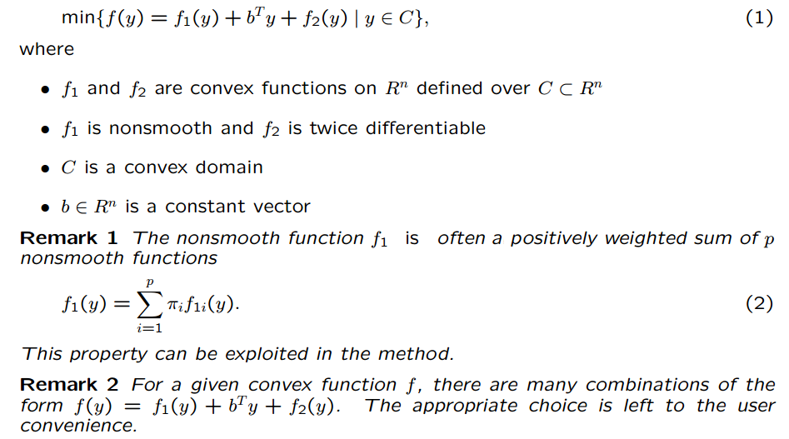
ProxACCPM – Canonical Problem
Project funded by the Swiss National Science Foundation
Claude Tadonki
Mines ParisTech
High Performance Computing as Combination of Machines and Methods and Programming
HDR defense - University Paris-Sud/Orsay - PCRI - May 16th 2013

Slide 15
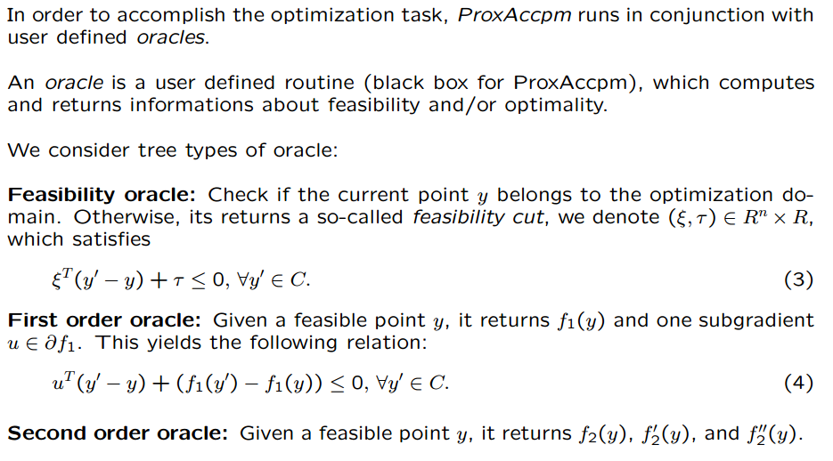
ProxACCPM – Oracles
Claude Tadonki
Mines ParisTech
High Performance Computing as Combination of Machines and Methods and Programming
HDR defense - University Paris-Sud/Orsay - PCRI - May 16th 2013

Slide 16
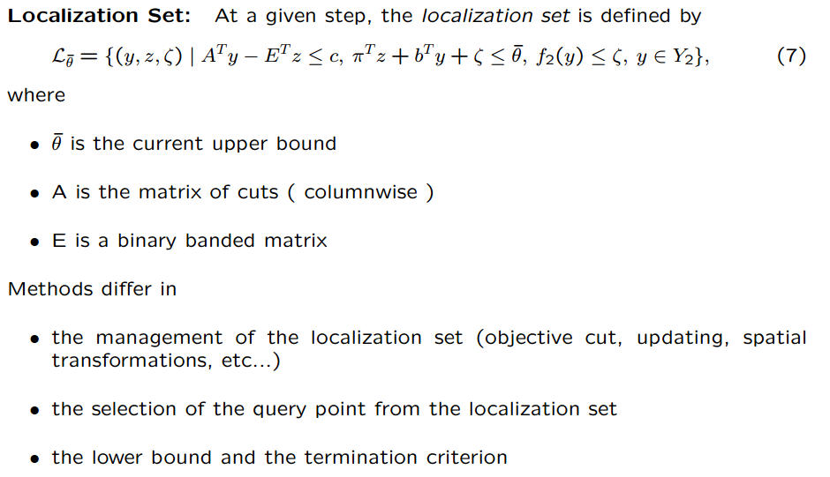
ProxACCPM – Localization Set
Claude Tadonki
Mines ParisTech
High Performance Computing as Combination of Machines and Methods and Programming
HDR defense - University Paris-Sud/Orsay - PCRI - May 16th 2013

Slide 17
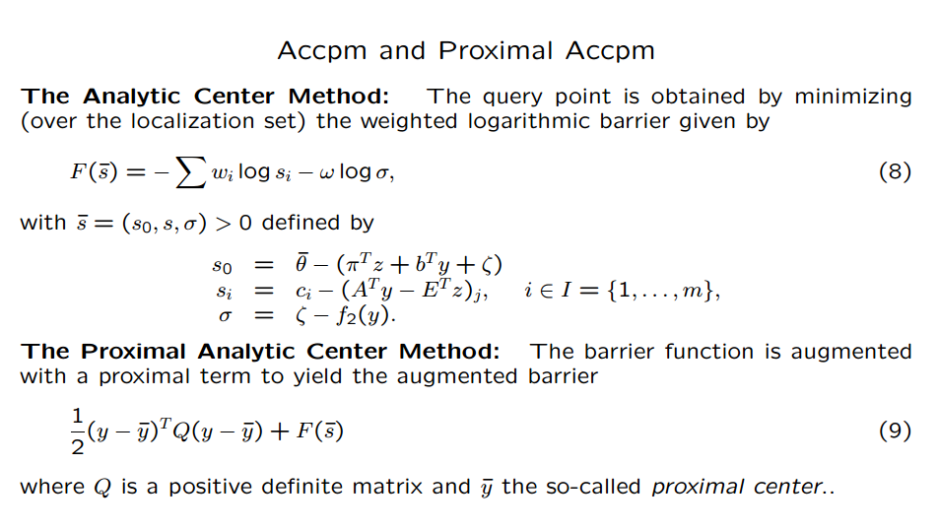
ProxACCPM – The heart
Claude Tadonki
Mines ParisTech
High Performance Computing as Combination of Machines and Methods and Programming
HDR defense - University Paris-Sud/Orsay - PCRI - May 16th 2013

Slide 18
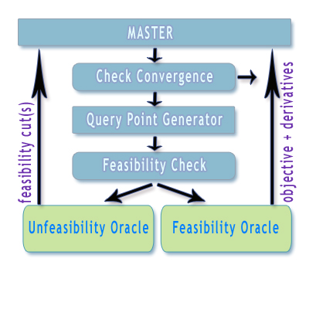
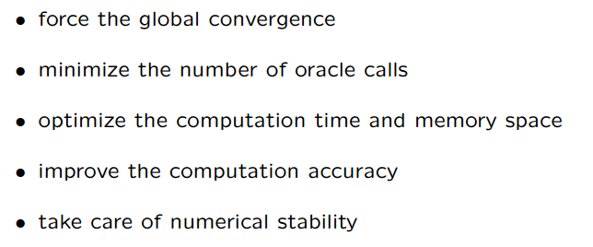
ProxACCPM – The machinery
The main concerns are
Babonneau, F., Beltran, C., Haurie, A., Tadonki, C. and Vial, J.-P., Proximal-ACCPM: a versatile oracle based optimization method, In Optimisation, Econometric and Financial Analysis, E. J. Kontoghiorghes editor, vol. 9 of Advances in Computational Management Science, 2006.
Achievements
Implementation of the method in a complete framework (https://projects.coin-or.org/OBOE).
Implementation as a query point generator for connection with other packages (branch and bound)
Several case studies published in journal and conferences
Some perspectives
Deep investigation of the parallelization on supercomputers (scheduling, scalability, load balance,…)
Study how to deal with updates instead of performing matrix computations from scratch at each step
Investigate on numerical issues with large-scale ill-conditioned systems
Sherman-Morrison formula
Approximation algorithms
Claude Tadonki
Mines ParisTech
High Performance Computing as Combination of Machines and Methods and Programming
HDR defense - University Paris-Sud/Orsay - PCRI - May 16th 2013

Slide 19

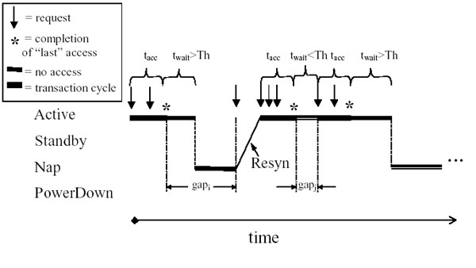
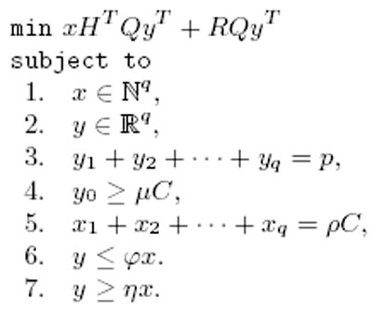
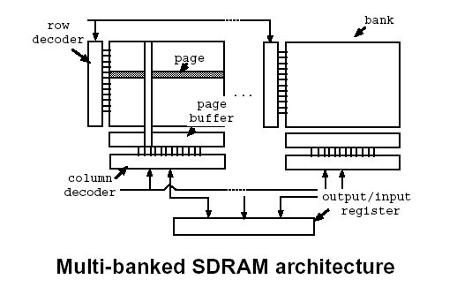
Energy Minimization
Power consumption is a crucial concern with embedded systems and supercomputers
Fujistsu K-Computer ≈ US$10 millions/year for electricity
Pr Jose Rolim
Theoretical Computer Science Laboratory (TCS Lab)
Centre Universtaire Informatique
University of Geneva (Switzerland)
My work on Power Aware Computing and Distributed Algorithms
were initiated from my stay at the TCS-Lab.
We focus on memory energy
The memory is partitionned into several banks
Each bank can be put into a specific power mode
We assume regular (uniform) power state transitions
We formulate and solve the optimization problem
Multi-states Memory Architecture
Good collaboration with Mitali Singh and Viktor Prasanna (University of Southern California)
Claude Tadonki
Mines ParisTech
High Performance Computing as Combination of Machines and Methods and Programming
HDR defense - University Paris-Sud/Orsay - PCRI - May 16th 2013

Slide 20

Energy Minimization
Input
Model and Optimization
Output
Hardware parameters : W, Q, H, p, q, and δ
Optimal Energy E
Power aware
program design
and monitoring
Program parameters : R, C
Optimal transition repartition X
Memory management parameters : ρ, ϕ, η
Optimal time repartition Y
Some perspectives are:
Design a methodology that will use the output of our work for a systematic synthesis of energy efficient policies
Extend and adapt our model to current and future memory systems (multilevel and shared)
Use a similar formal approach to analyse the energy issue on the cloud systems (user and provider)
Investigate on other approaches (dynamic scheduling, compilation, …)
One of our proposal on this topic received an important grant from the
Swiss National Science Foundation
We have been also investigating on:
Distributed algorithm in sensors networks (localization and information retrieval)
Dual-power management problem (mathematical programming approach and heuristics)
Algorithms for the web (search engines and social networks)
Claude Tadonki
Mines ParisTech
High Performance Computing as Combination of Machines and Methods and Programming
HDR defense - University Paris-Sud/Orsay - PCRI - May 16th 2013

Slide 21

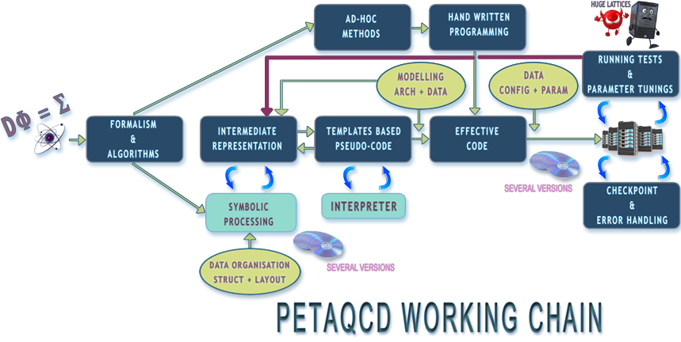
PetaQCD – Overview
ANR Project (HPC & Particles Physics)
Origin of the universe (matter)
National: G. Grosdidier (coordinator), P. Roudeau, O. Pène, C. Tadonki, K. Petrov, D. Barthou, M. Kruse, C. Eisenbeis, B. Blossier, L. Morin, F. Bodin, F. Touze, O. Brand-Foissac, J. C. Angles d’Auriac, A. Seznec, A. Cohen, C. Bastoul, and more.
Abroad: K. Urbach, K. Jansen, L. Scorzatto, D. Pleiter, R. Tripiccione
Good cooperative effort
Multidisciplinary collaboration
HPC & numerical challenges
Lot of materials and outputs of this
project can be found here
https://www.petaqcd.org
Claude Tadonki
Mines ParisTech
High Performance Computing as Combination of Machines and Methods and Programming
HDR defense - University Paris-Sud/Orsay - PCRI - May 16th 2013

Slide 22
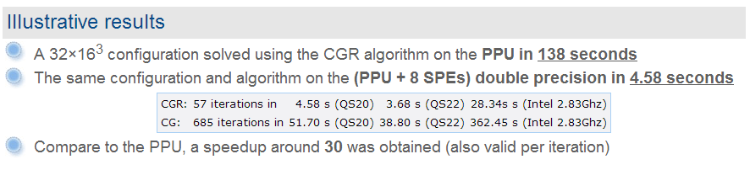
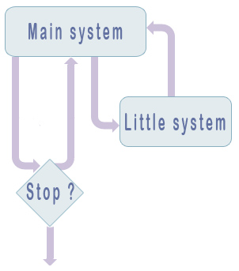
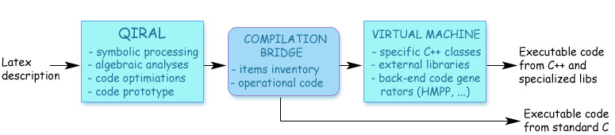
PetaQCD – Contributions
Hybrid extension of the reference package (tmLQCD) using Pthread library
Accelerated algorithm & implementation of the Dirac operator and other linear algebra kernels
C. Tadonki, G. Grosdidier, and O. Pene, « An efficient CELL library for Lattice Quantum Chromodynamics »,
ACM SIGARCH Computer Architecture News, vol 38(4) 2011.
Block decomposition
C. Tadonki, «Strengthening deflation implementation»
for large scale LQCD inversions, Orsay, Sept. 27th – 28th 2012
We have implemented a generic block decomposition (multidimensional and with no restriction on the number of blocks per axis) within the tmLQCD package. The aim is to increase the basis of the deflation method (to solve large ill-conditioned systems) without
Code generation
D. Barthou, G. Grosdidier, M. Kruse, O. Pene and C. Tadonki,
« QIRAL: A High Level Language for Lattice QCD Code Generation »,
Programming Language Approaches to Concurrency and Communication-cEntric Software (PLACES'12) in conjunction with the European joint Conference on Theory & Practice of Software (ETAPS), Tallinn, Estonia, March 24-April 1, 2012.
Claude Tadonki
Mines ParisTech
High Performance Computing as Combination of Machines and Methods and Programming
HDR defense - University Paris-Sud/Orsay - PCRI - May 16th 2013

Slide 23
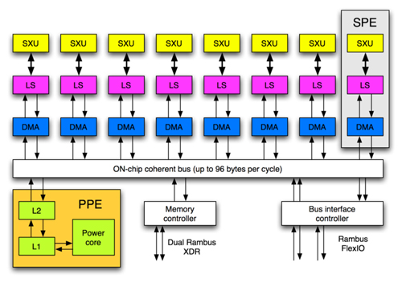

Accelerated Computing
I start investigating on this topic from my collaboration with Dr Lionel Lacassagne
(ANR project Ocelle 2007-2009), also SIMD and Image Processing stuffs.
Good collaboration with Dr Joel Falcou, Tarik Saidani, Khaled Hamidouche, and Pr Daniel Etiemble
T. Saidani, J. Falcou, C. Tadonki, L. Lacassagne, and D. Etiemble,
« Algorithmic Skeletons within an Embedded Domain Specific Language for the CELL Processor »,
Parallel Architectures and Compilation Techniques (PACT), PACT09, Raleigh, North Carolina (USA), September 12-16, 2009.
Claude Tadonki
Mines ParisTech
High Performance Computing as Combination of Machines and Methods and Programming
HDR defense - University Paris-Sud/Orsay - PCRI - May 16th 2013

Slide 24
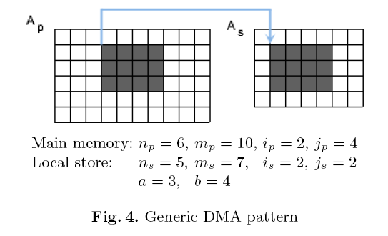
Accelerated Computing – Generic DMA
DMA issues related to tiling
Performing the transfer expressed in figure 4 raises number of problems:
• the region to be transferred is not contiguous on memory, thus list DMAs are considered
• the address of one given row is not aligned, thus the global list DMA is not possible
• the (address, volume) pair of a row does not match the basic DMA rules (the above two
ones), thus the entire list DMA cannot be carried out
• misalignment could come from both sides (main memory and/or local store)
• the target region on the local store might be out of the container limits
We have designed and implemented a routine which performs this task very efficiently
Claude Tadonki
Mines ParisTech
High Performance Computing as Combination of Machines and Methods and Programming
HDR defense - University Paris-Sud/Orsay - PCRI - May 16th 2013

Slide 25
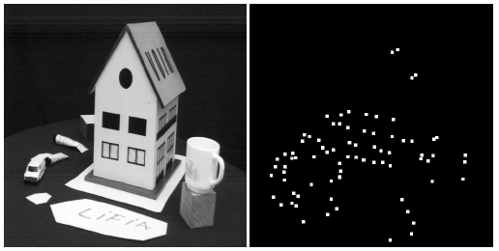

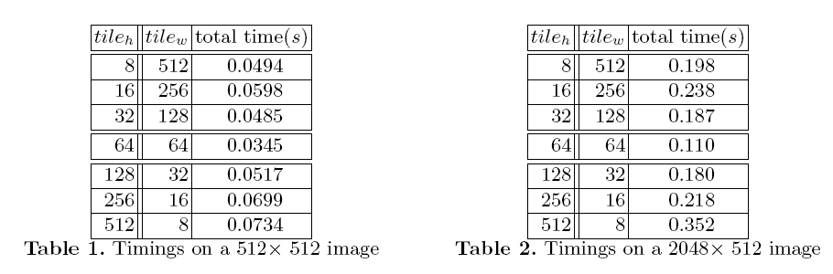
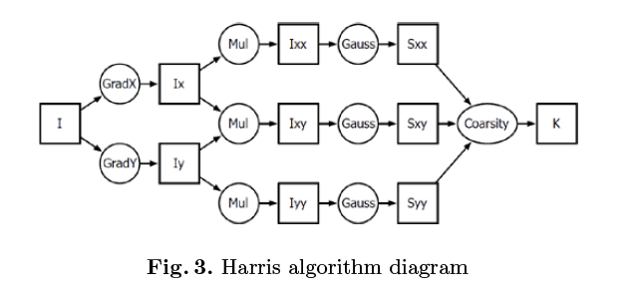

Accelerated Computing – Harris Algorithm
The Harris-Stephen algorithm is
a corner (point of interest) detection algorithm
an improved variant of the original algorithm by Moravec
used in computer vision for feature extraction like
  motion detection
  image matching
  tracking
  3D reconstruction
  object recognition
Technically, the Harris algorithm is based on a pixelwise autocorrelation S given by
where (x, y) is the location of the pixel and I(x, y) its intensity (grayscale mode).
C. Tadonki, L. Lacassagne, E. Dadi, M. Daoudi,
«Accelerator-based implementation of the Harris algorithm»,
5th International Conference on Image Processing (ICISP 2012), June 28-30, 2012.
We observe 50% improvement between square tiles and full row tiles.
Claude Tadonki
Mines ParisTech
High Performance Computing as Combination of Machines and Methods and Programming
HDR defense - University Paris-Sud/Orsay - PCRI - May 16th 2013

Slide 26








PetaQCD – Algebraic Path Problem
PPE-DMA is issued only by the first and the last processor
Inner SPEs communicate and synchronize locally
Computation-communication overlap occurs for all communications
Can run on more SPEs or CELL Blades by natural extension
C. Tadonki, « Ring pipelined algorithm for the algebraic path problem on the CELL Broadband Engine »,
WAMMCA 2010 - SBAC PAD 2010, Petropolis, Rio de Janeiro, Brazil, October 27-30, 2010. (IEEE digital library)
Claude Tadonki
Mines ParisTech
High Performance Computing as Combination of Machines and Methods and Programming
HDR defense - University Paris-Sud/Orsay - PCRI - May 16th 2013

Slide 27



Accelerated Computing – LQCD library
C. Tadonki, G. Grosdidier, and O. Pene, «An efficient CELL library for Lattice Quantum Chromodynamics»,
HEART - ACM/ICS, Epochal Tsukuba, Tsukuba, Japan, June 1-4, 2010.
Claude Tadonki
Mines ParisTech
High Performance Computing as Combination of Machines and Methods and Programming
HDR defense - University Paris-Sud/Orsay - PCRI - May 16th 2013

Slide 28



UNIVERSAL REPORT: A Universal Source Code Analysis and Documentation Software
Basic, C, C++, COBOL, Fortran, Java, Javascript, Matlab, Pascal, Visual Basic, Borland C++ Builder, Delphi, Kylix, Perl, PL1, Python, Visual C++, Visual Basic .Net, Visual C#, Visual J++, and more
Prestigious custumers
NASA - Northrop Grumman Corporation
www.omegacomputer.com
Claude Tadonki , « Universal Report: A Generic Reverse Engineering Tool »,
12th IEEE International Workshop on Program Comprehension, IWPC 2004 , University of Bari, Bari, Italy , June 2004 ,
Claude Tadonki
Mines ParisTech
High Performance Computing as Combination of Machines and Methods and Programming
HDR defense - University Paris-Sud/Orsay - PCRI - May 16th 2013

Slide 29



Cooperations
Cooperation with Brazil
BioCloud project of the STIC-AmSud
Sandwich PhDs (Brazilia/Rio/Niteroi)
Papers, visitings, events, courses
Other Latin America partners (Chile, …)
+ INRIA and Paris-Sud University
Cooperation with Morocco (Oujda)
Sandwich PhDs
Papers, visitings, seminars
Cooperation at Mines ParisTech
TIMC project (multi-target images)
CMM (Math Morphology) and CAOR
BioCloud Partners at Orsay
Claude Tadonki
Mines ParisTech
High Performance Computing as Combination of Machines and Methods and Programming
HDR defense - University Paris-Sud/Orsay - PCRI - May 16th 2013

Slide 30

Special Dedication
In memory of Jean Tadonki (1939-2001)
« You are the greatest »
Claude Tadonki
Mines ParisTech
High Performance Computing as Combination of Machines and Methods and Programming
HDR defense - University Paris-Sud/Orsay - PCRI - May 16th 2013

Slide 31

Special Dedication
Thanks to all of you
Family, friends, colleagues, collaborators, advisors, examiners, referees, administration, technicians, audience, you, …
Claude Tadonki
Mines ParisTech
High Performance Computing as Combination of Machines and Methods and Programming
HDR defense - University Paris-Sud/Orsay - PCRI - May 16th 2013

